Slide 1
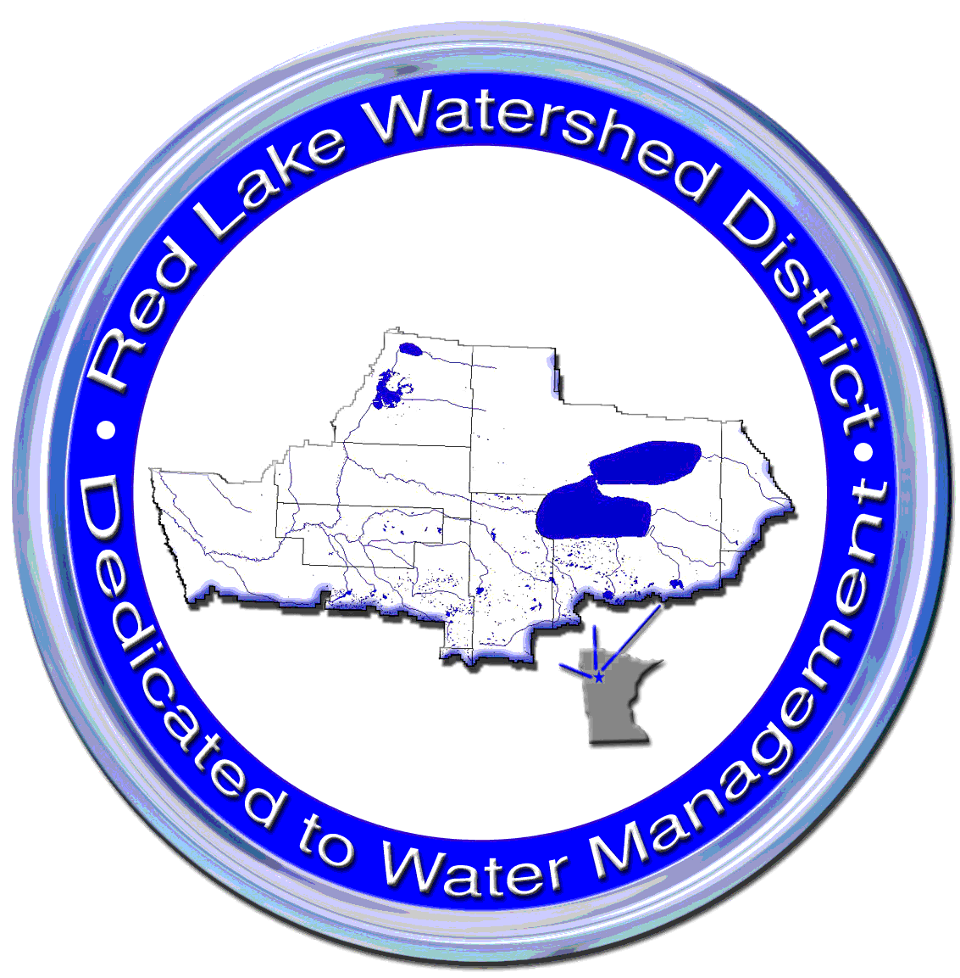
Red Lake River Watershed Restoration and Protection Project
April 2013
Stakeholders’ Update Meeting

Slide 2
Red Lake River Major Sub-Watershed

Slide 4
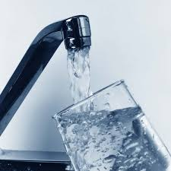
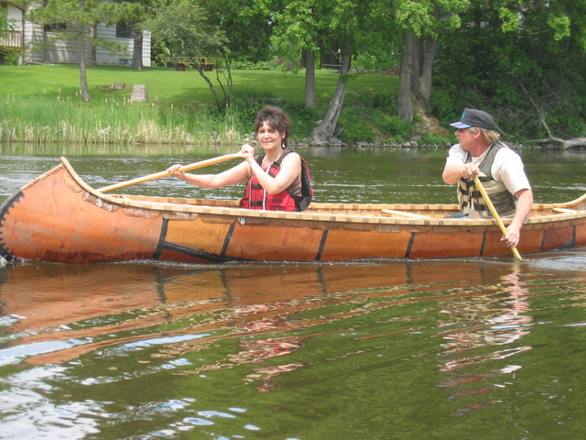
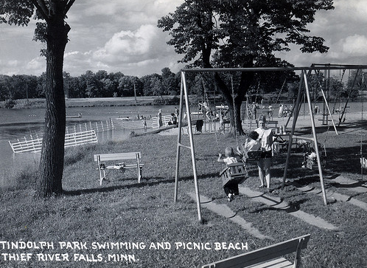
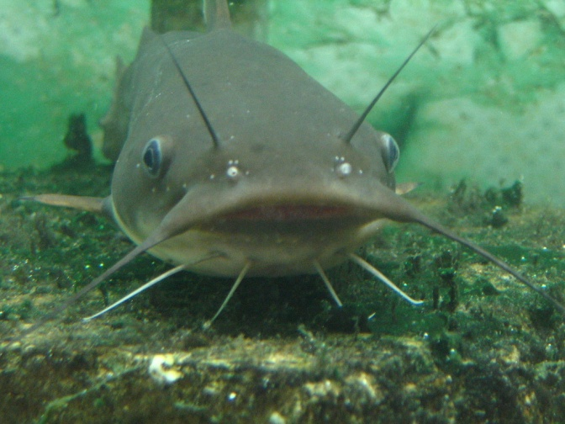
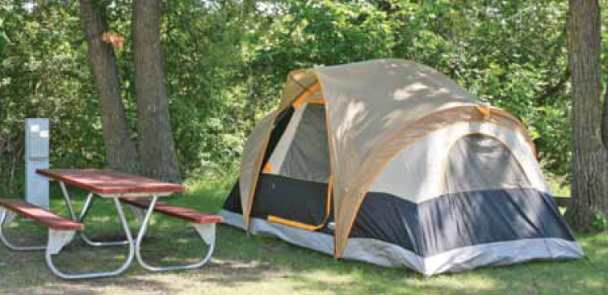
Importance of the Red Lake River

Slide 5
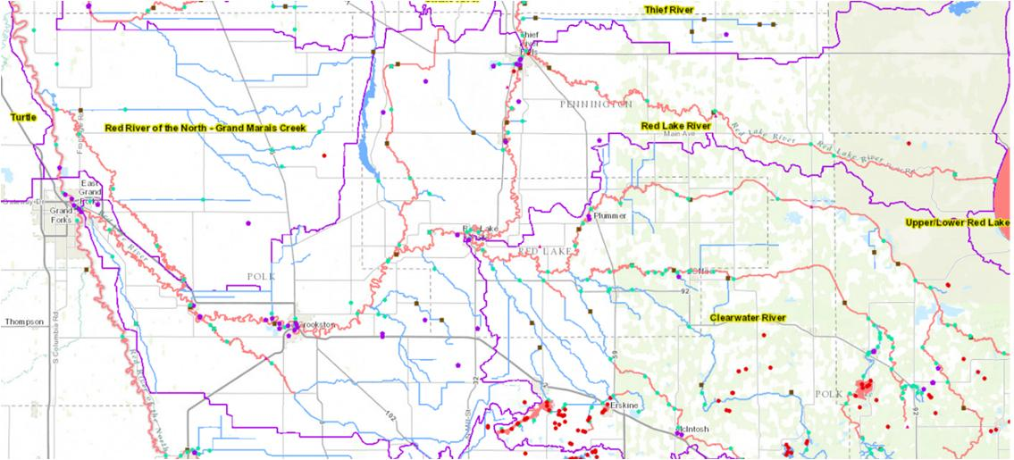
History of Red Lake River Water Quality Monitoring
RLWD, Soil and Water Conservation Districts, International Water Institute, River Watch, USGS, Red Lake DNR, MPCA

Slide 6
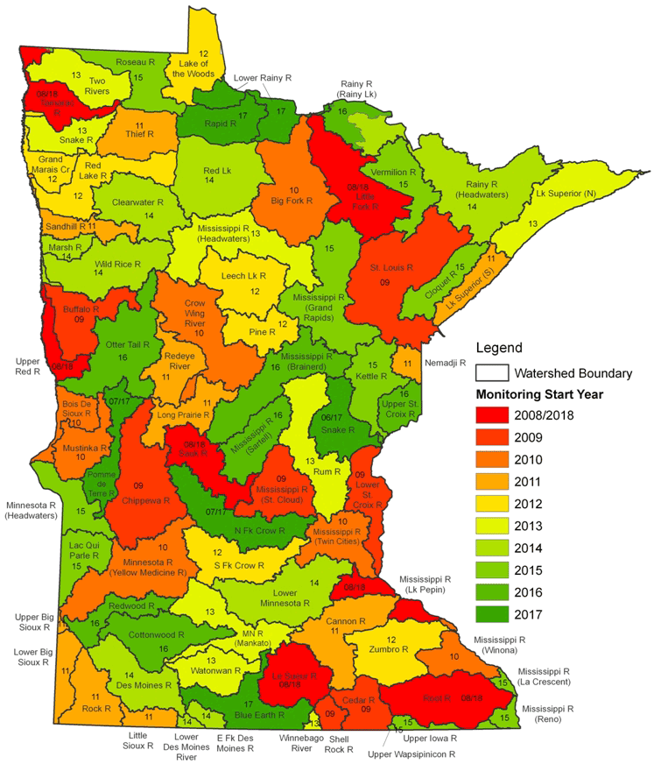
Red Lake River WRAP Project
$150,000+ for Phase I
$100,000 for Phase II
$100,000 for the development of a HSPF Model of the Watershed
$86,514 Surface Water Assessment Grant

Slide 7
Assessment of Water Quality Data

Slide 8
Assessment of Water Quality Data

Slide 9
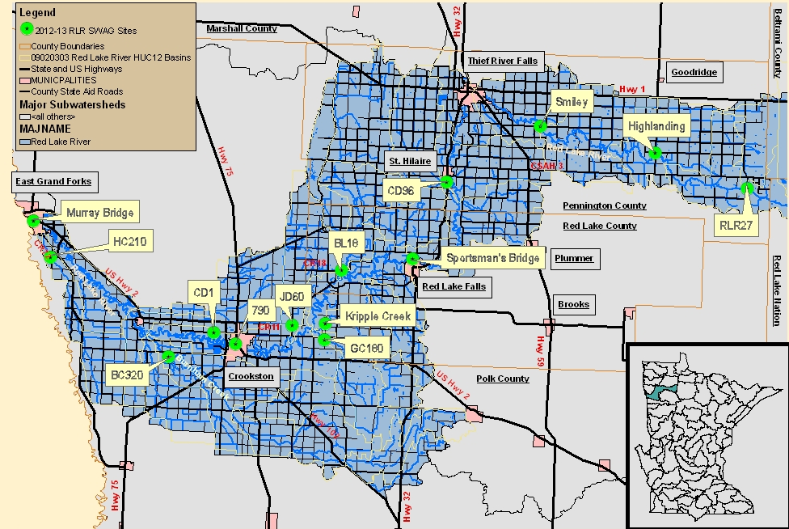
Water Quality Monitoring
Surface Water

Slide 10
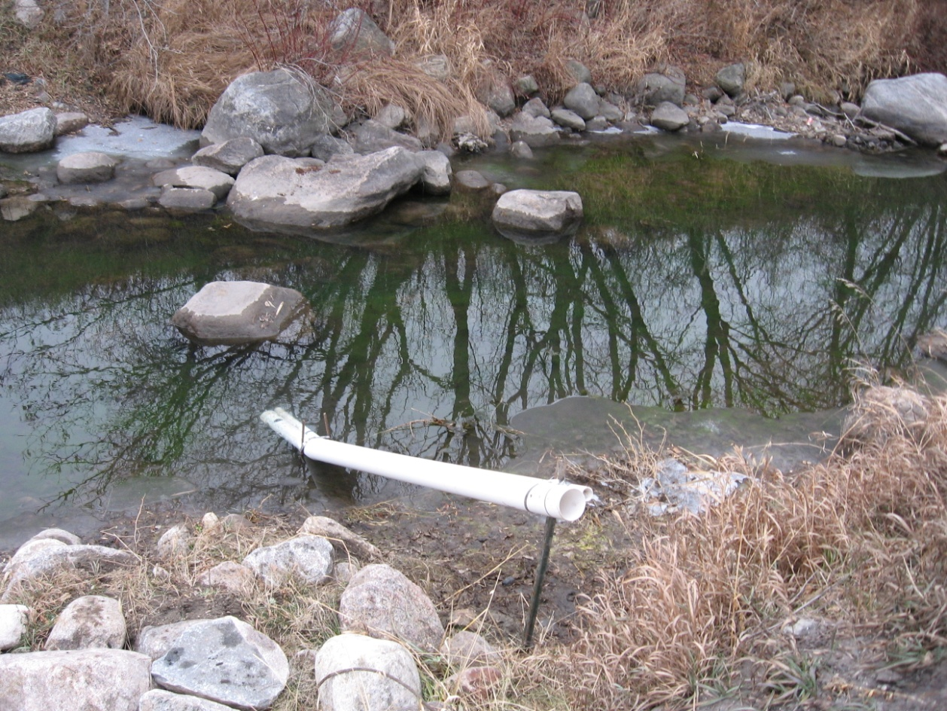
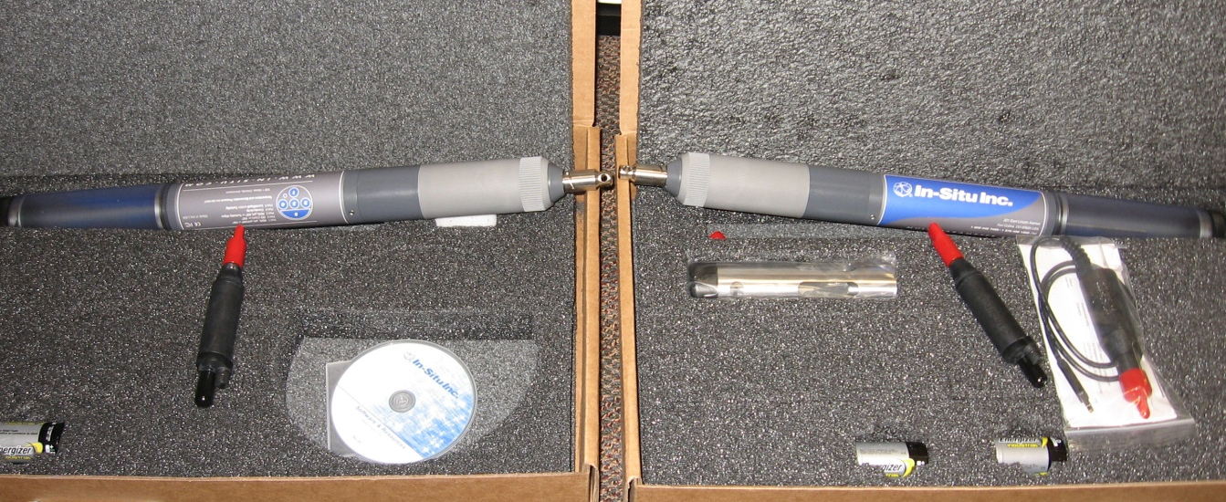
Continuous Water Quality Monitoring

Slide 11
Continuous Water Quality Monitoring
Kripple Creek

Slide 12
Continuous Water Quality Monitoring
Burnham Creek

Slide 13
Continuous Water Quality Monitoring
Black River

Slide 14
Continuous Water Quality Monitoring
Gentilly Creek

Slide 15
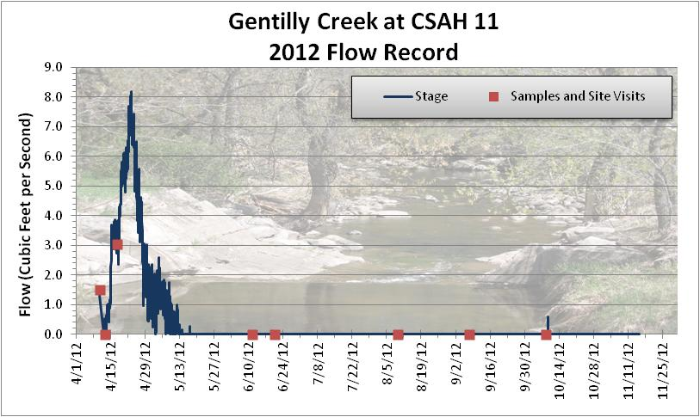
Stage and Flow Monitoring

Slide 16
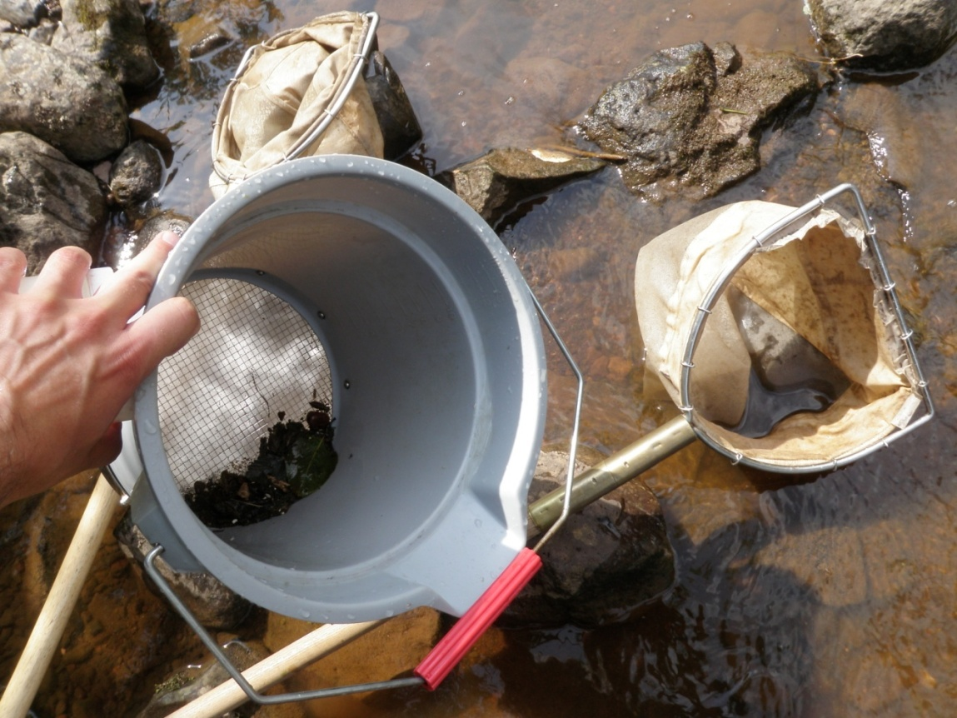
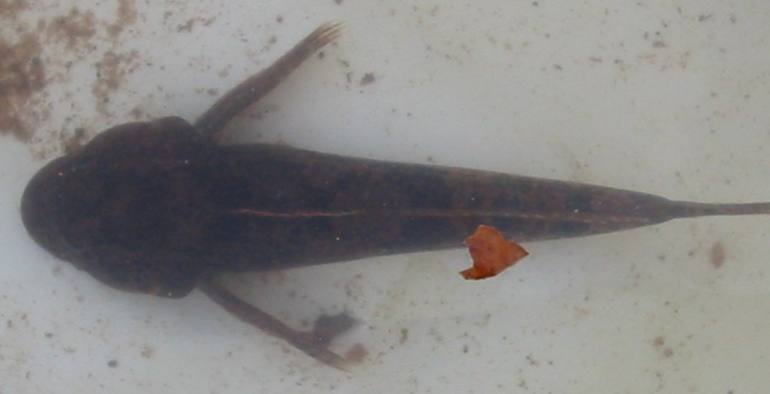
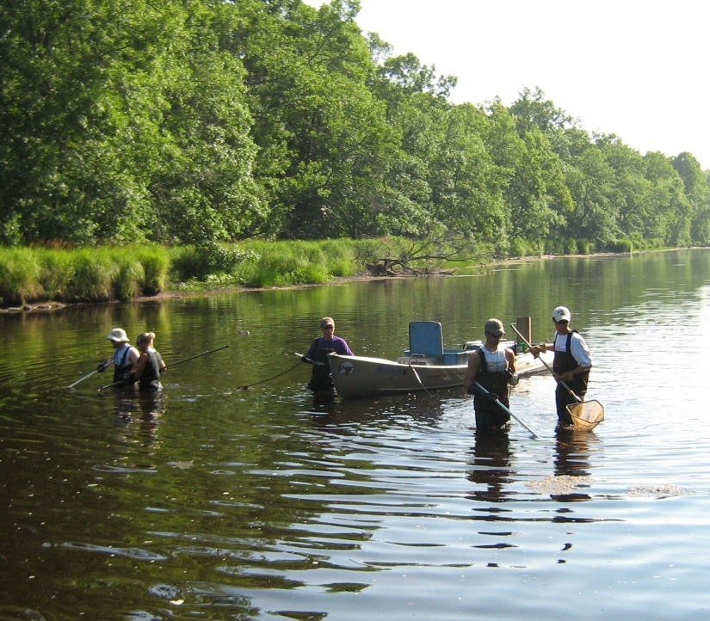
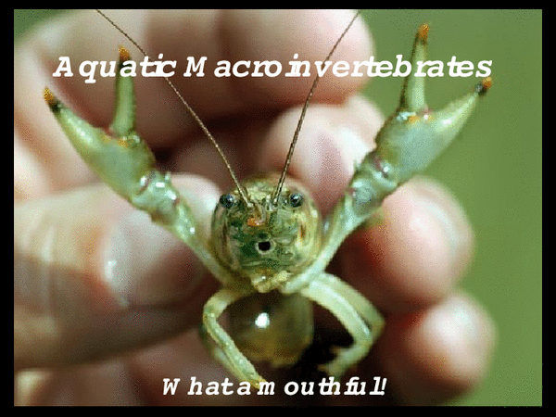
Biological Monitoring

Slide 18
Notes:
Fish sample pictures.

Slide 19
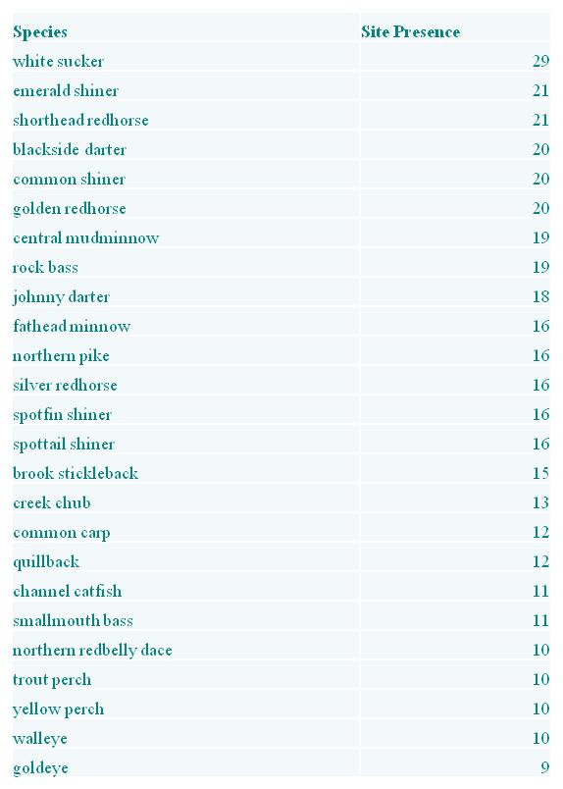
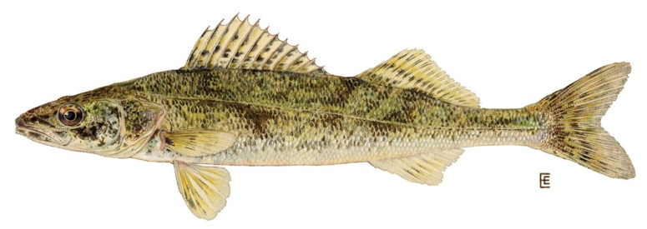
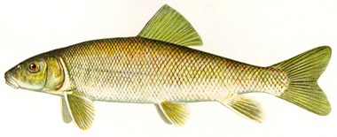
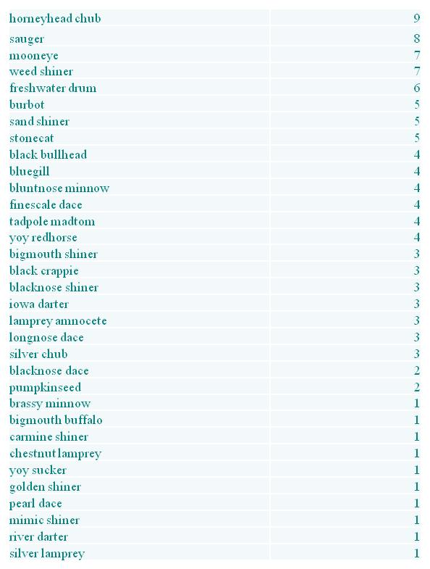
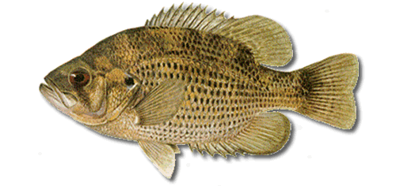
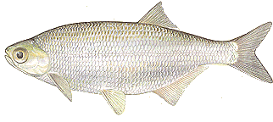
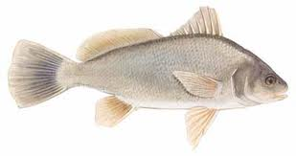
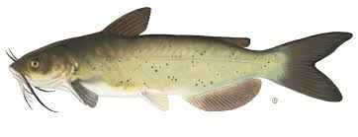
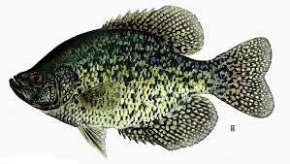
Species Presence
29
8
19
7
16
11
6
11
10
3
1
10

Slide 20
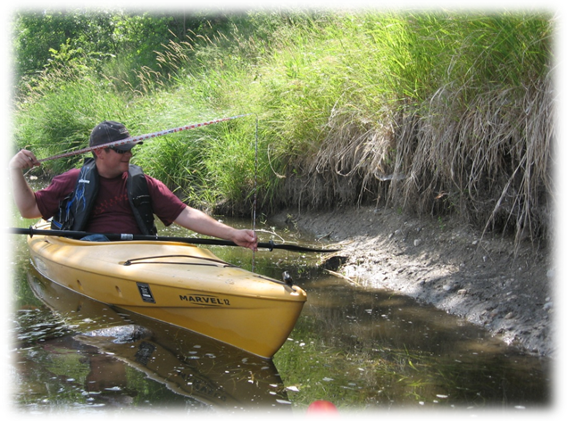
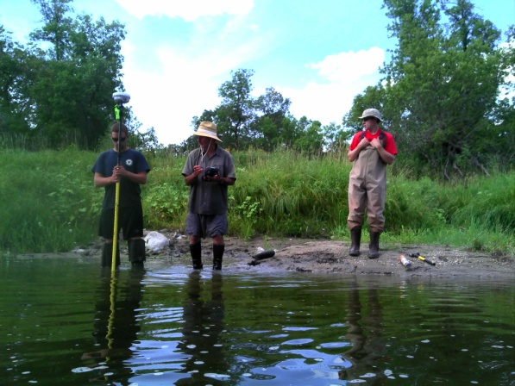
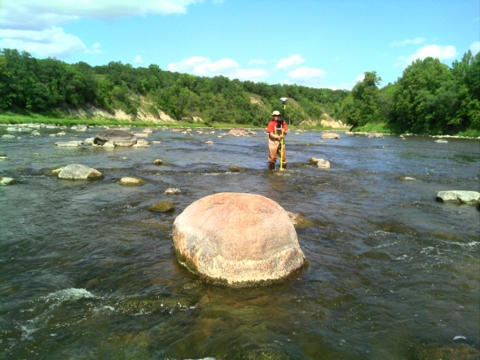
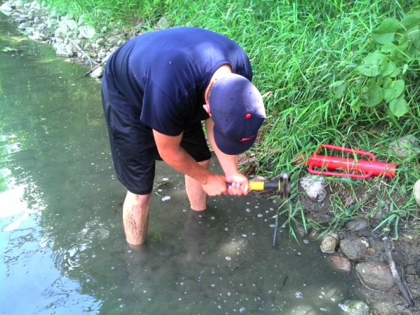
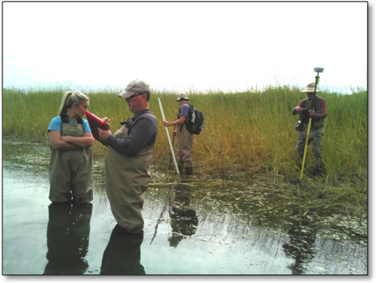
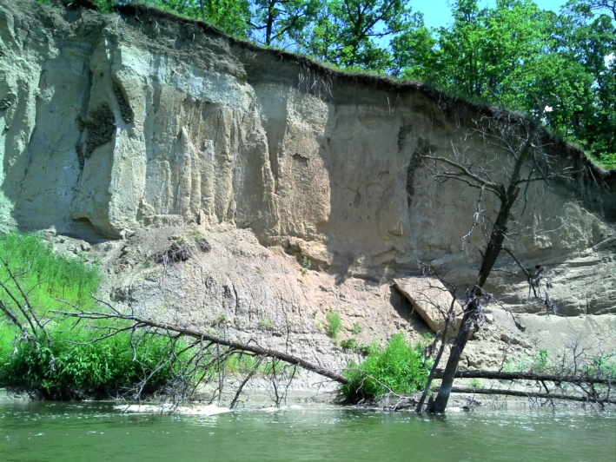
Stream Channel Stability Assessment (Geomorphology)

Slide 21
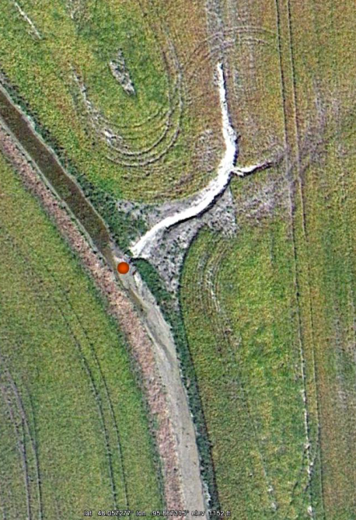
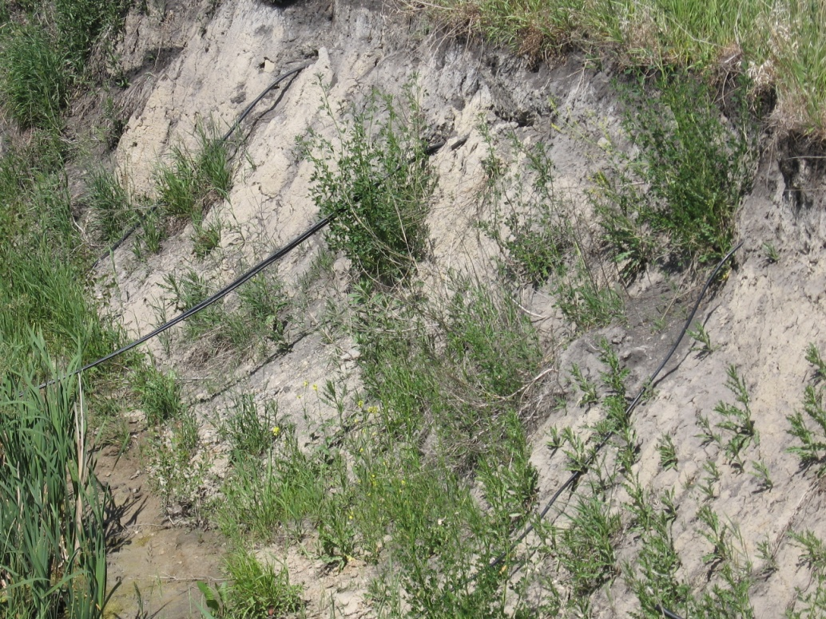
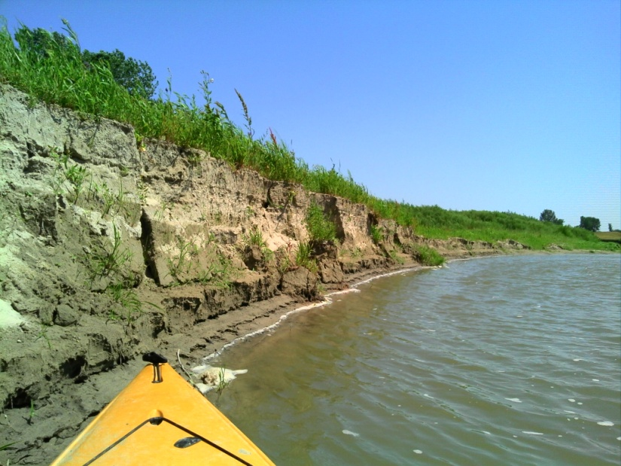
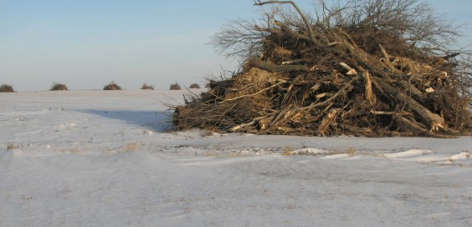
Stressor Identification
Notes:
Nick’s photos, photos from kayaking, cow in the Red Lake River by CSAH 27

Slide 22
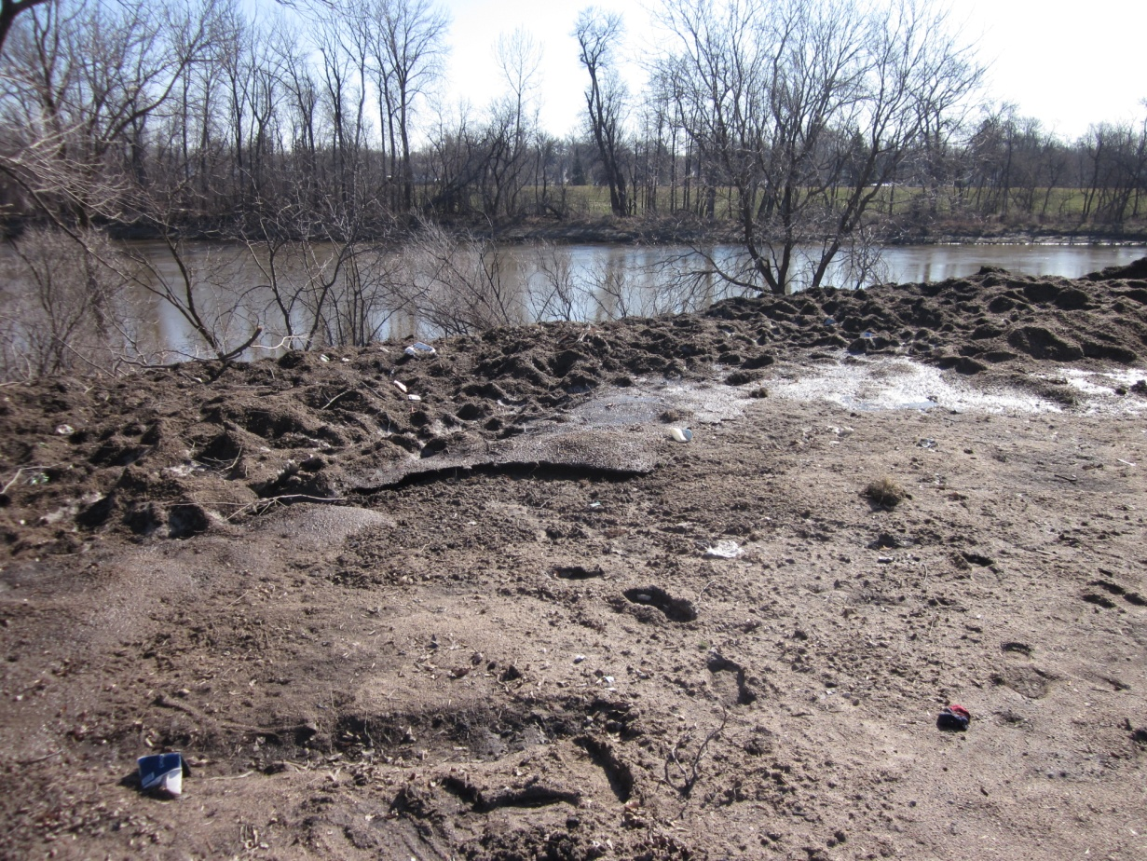
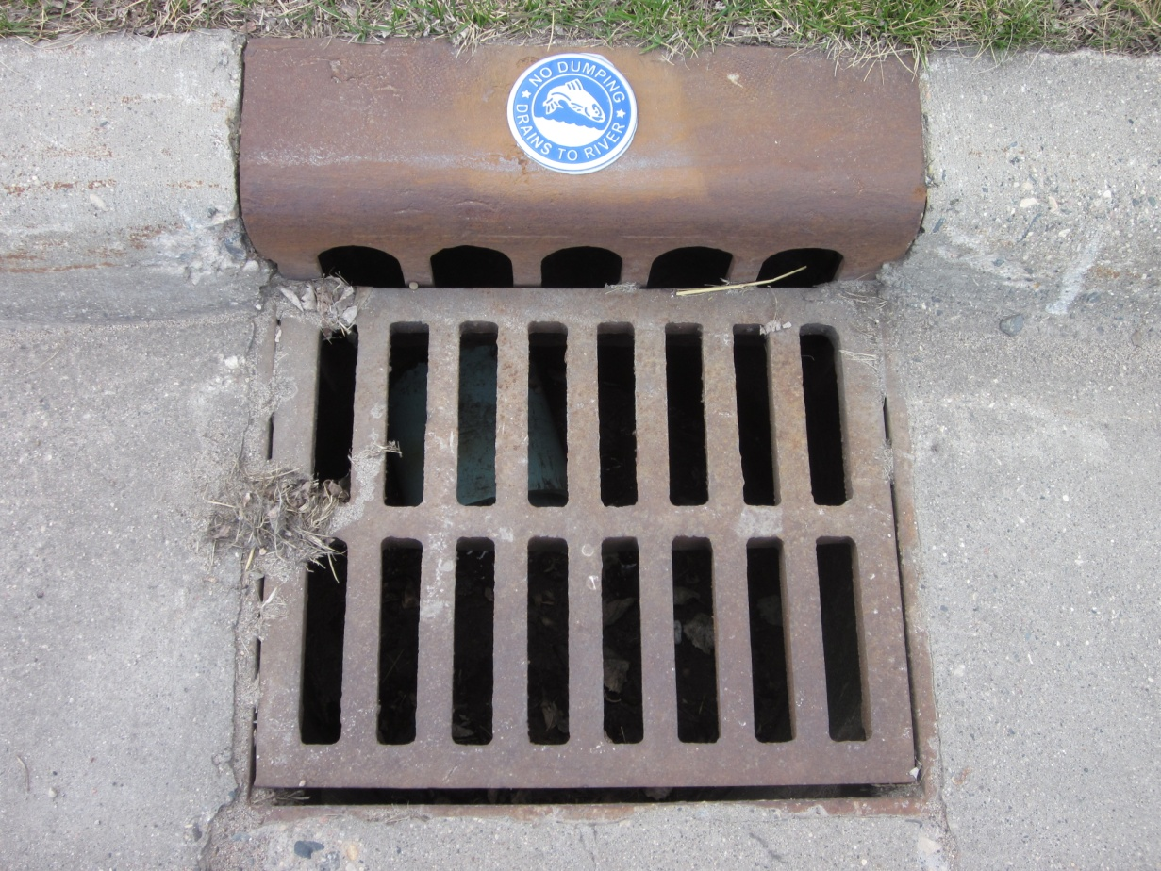
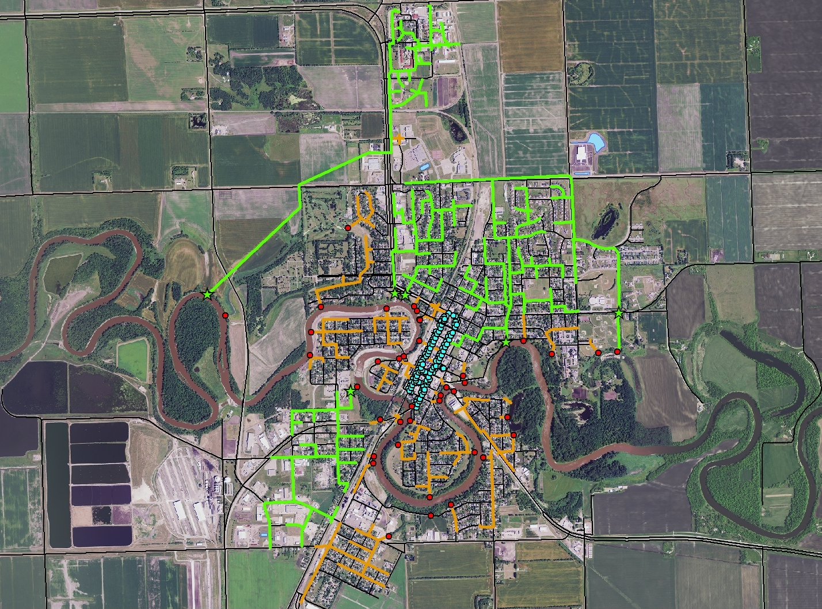
Crookston Stormwater Study

Slide 23
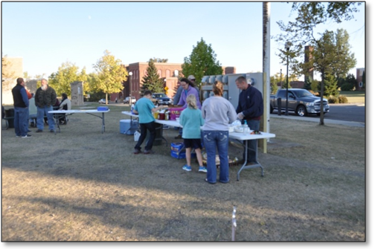
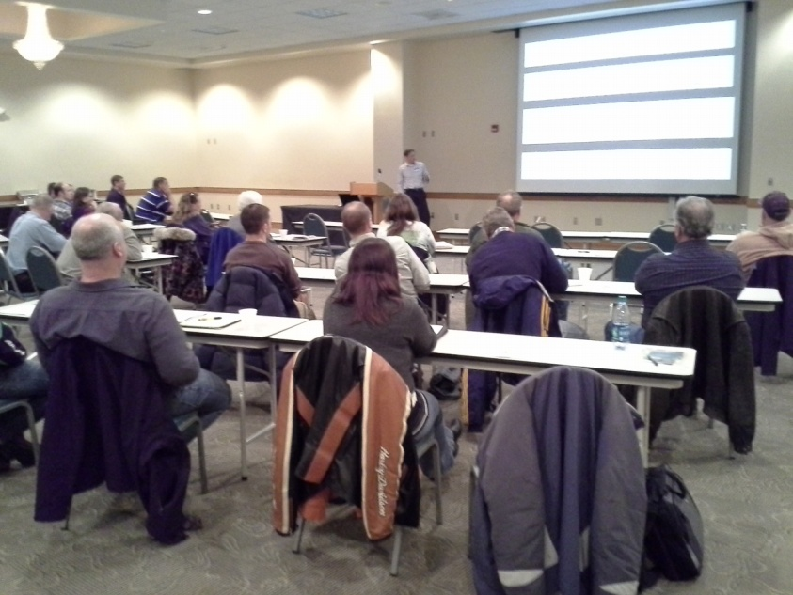
Civic Engagement
Lori Clark of RMB Environmental Laboratories, has been hired as a subcontractor
Expansion of public outreach and involvement

Slide 24
LIDAR Terrain Analysis Stream Power Index Development

Slide 25
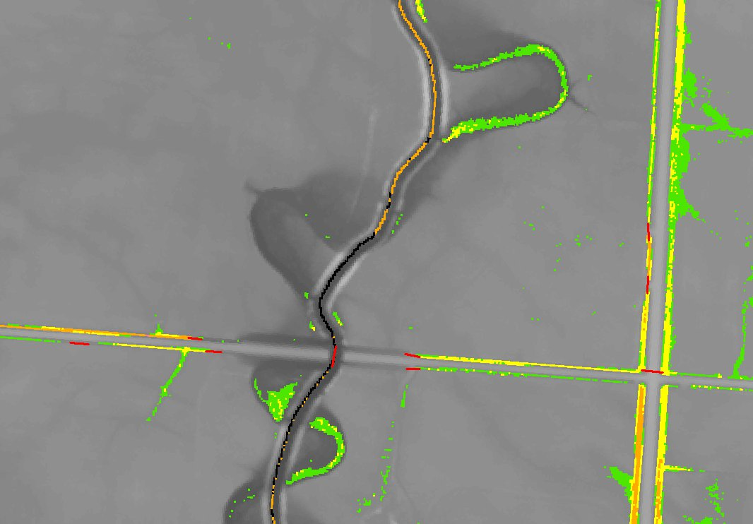
LIDAR Terrain Analysis Stream Power Index Development

Slide 26
LIDAR Terrain Analysis Stream Power Index Development

Slide 27
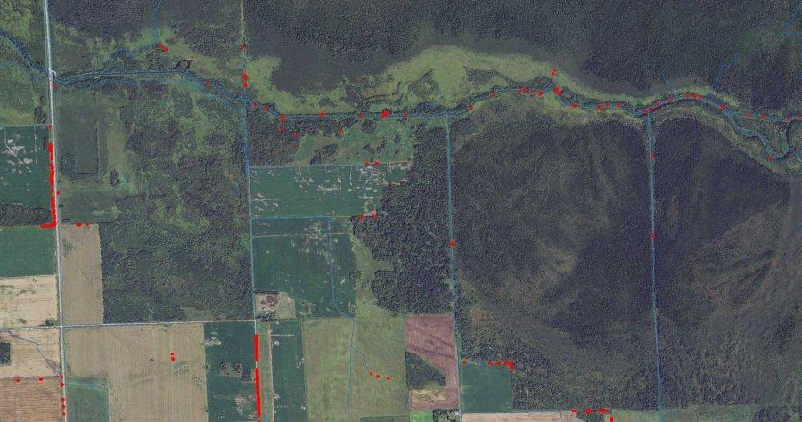
LIDAR Terrain Analysis Stream Power Index Development

Slide 28
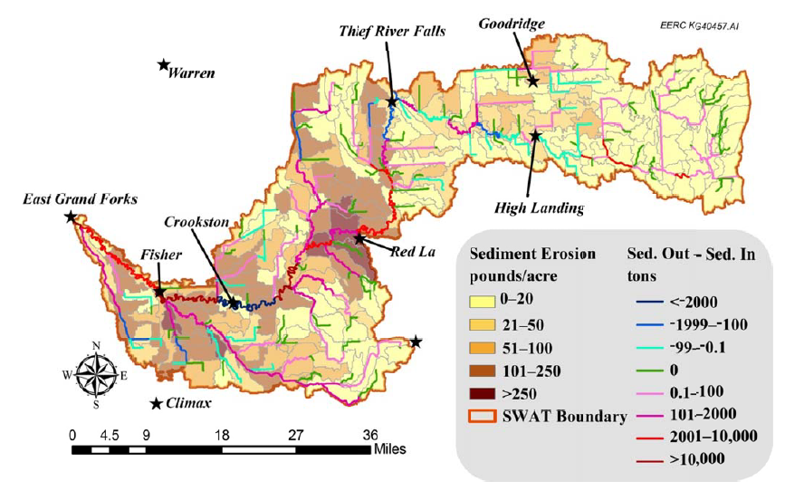
Water Quality Modeling - SWAT
SWAT (Completed)

Slide 29
HSPF Modeling

Slide 30
Restoration Plans Protection Plans
TMDL (restoration) report for each impairment that is verified/discovered from available monitoring data
Protection plan that covers the reaches that aren’t impaired.
We can still address the pollutant sources that we find whether there is an official TMDL or not

Slide 31
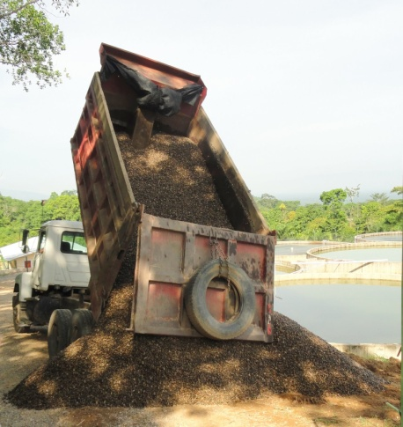
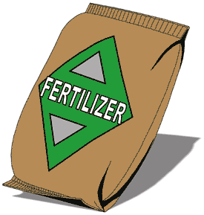
What is a TMDL?
Like a Pollutant Budget or Diet
Addresses Point and Nonpoint pollution
Equation
Expressed in pounds, tons , or number of organisms
Regulatory “teeth” of the program limited to MPCA permitting processes

Slide 32
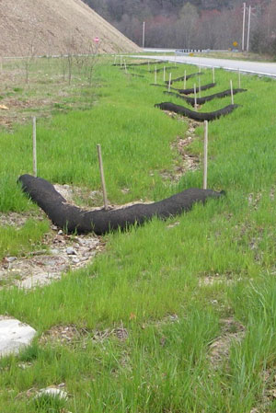
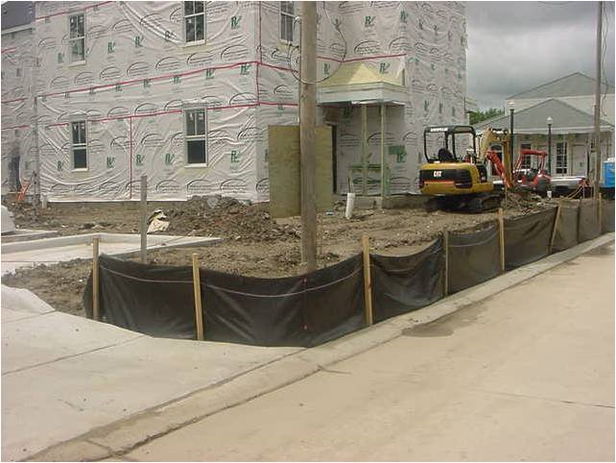
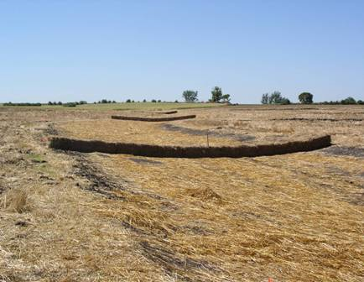
Changes in Permitting Requirements
Wastewater treatment facilities
Stormwater permits
Special conditions in stormwater permits (BMPs)
Designated MS4 City Stormwater Permitting

Slide 33
Importance of TMDL$
Required by the United States Environmental Protection Agency
Based on water quality standards established in Minnesota State statutes.
Streams assessed with locally collected data
Lots of money involved in the establishment of TMDLs and carrying-out implementation plans

Slide 34
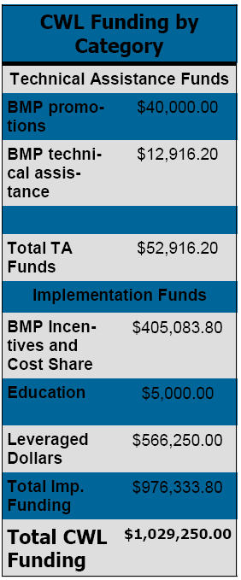
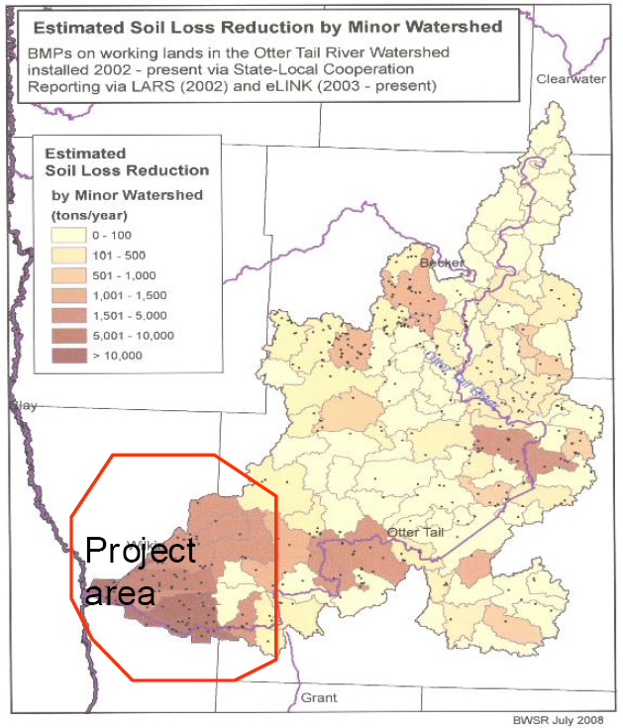
Restoration Funding for Projects
Example: Lower Otter Tail Turbidity TMDL
$480,000 grant from MPCA
>$1,000,000 in total funding

Slide 35
2013 Plans
Finish Phase I, start Phase II
Finish SWAG Sampling
Dissolved oxygen loggers in the Upper Red Lake River, JD60, CD96, and Browns Creek (or Kripple Creek)
Flow Measurements
Follow-up geomorphology work

