Slide 1

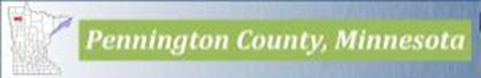




One Watershed One Plan – Thief River Watershed
Notes:
The 7 LGUs involved with the Thief River 1W1P are Beltrami, Marshall, and Pennington Counties. Beltrami, Marshall, and Pennington SWCDs and the RLWD.

Slide 2
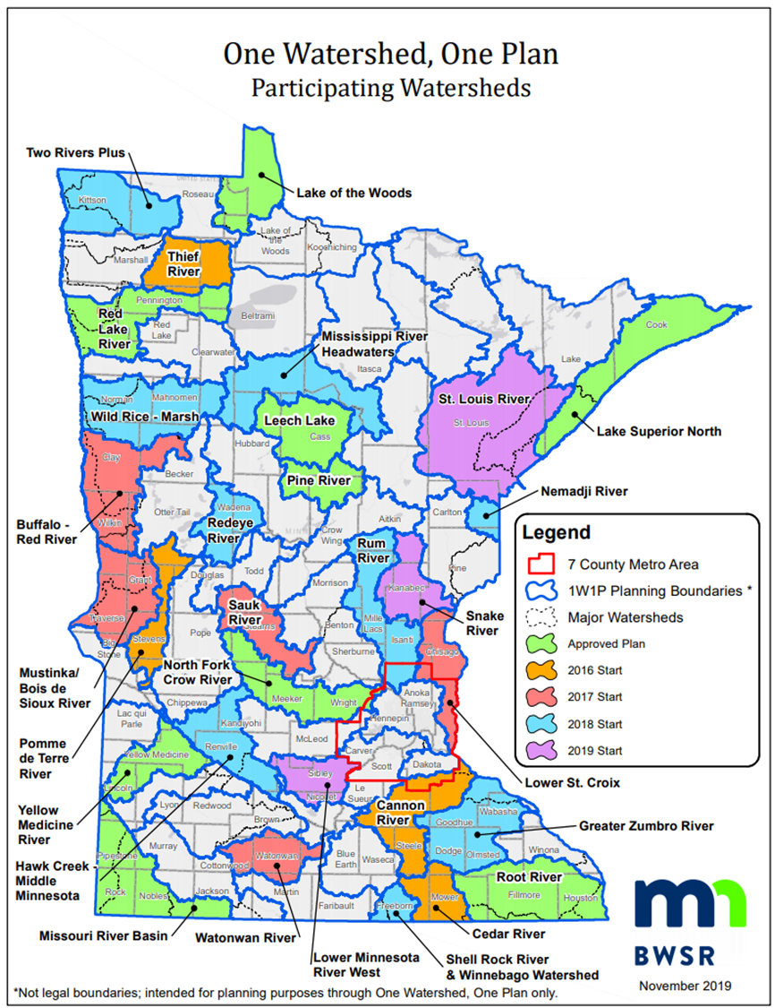
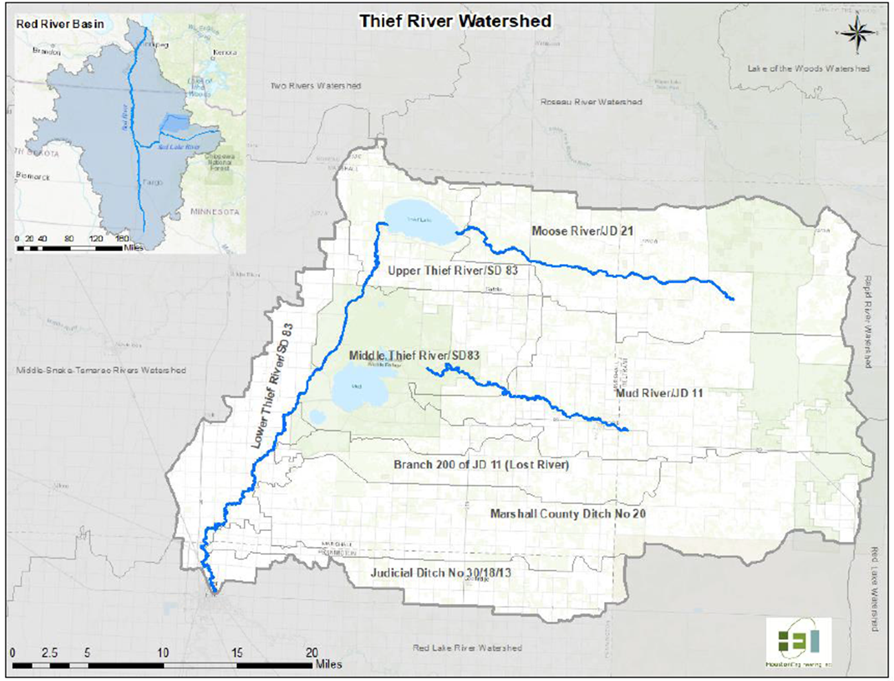
Notes:
The Thief River Watershed in NW MN covers portions of Beltrami, Marshall, and Pennington Counties and the Red Lake Watershed District. The watershed drains about 1,048 square miles or 671,024 acres. 8 planning regions were established based on the HUC 10 boundaries. The municipalities include Fourtown, Goodridge, Grygla, Holt, and part of the Thief River Falls. The City of Thief River Falls drinking water supply intake is on the Red Lake River just downstream of the confluence with the Thief River.

Slide 3
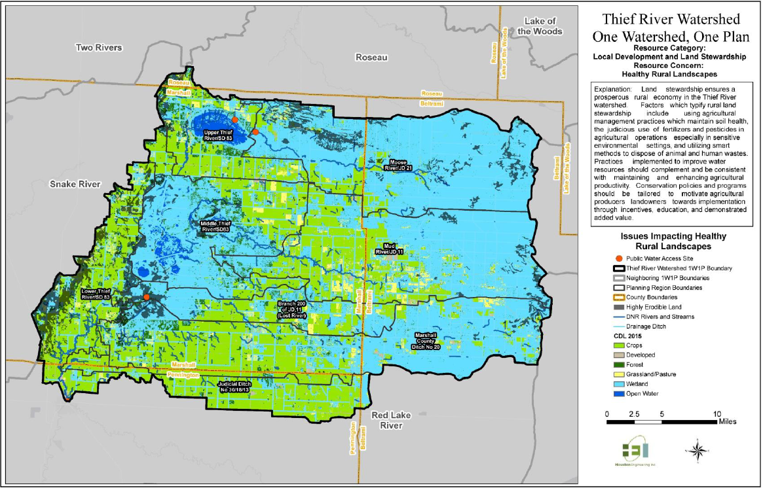
Land Use
45% wetlands
36% cropland
Notes:
Land use is dominated by cropland (36%) and wetlands (45%). The remaining landcover is 8% pasture/hay, 7% forest, 3% developed, and 2% open water (2014 MPCA). The green area is crop land and the light blue is wetlands. Yellow is pasture land or grassland and dark green is forest land.

Slide 4
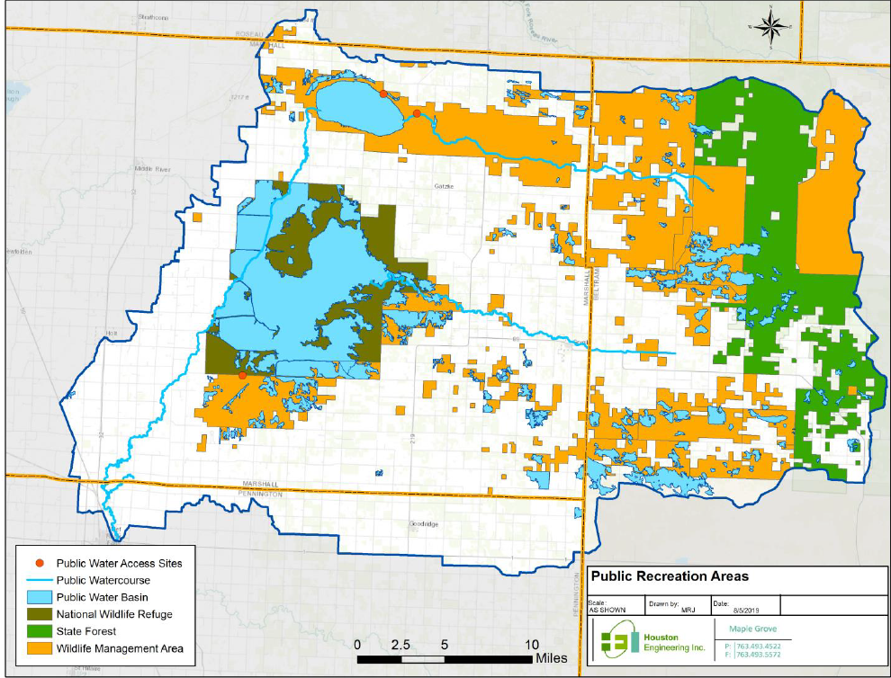
Public Lands
Agassiz National Wildlife Refuge
Beltrami Island State Forest
Thief Lake WMA
Moose River WMA
33 WMAs
Notes:
About 50% of land in the watershed is public lands with Agassiz National Wildlife Refuge covering 61,500 acres or almost 10% of the watershed.

Slide 5
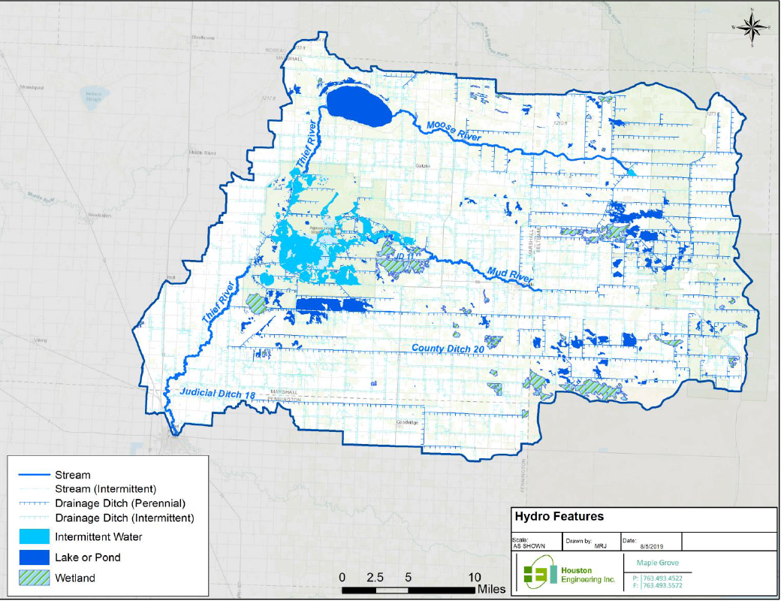
Hydrology
1,248 miles of legal ditches
3rd most channelized in the State
Notes:
There are 1,148 miles of legal drainage systems, which is 3rd most channelized in the state (based on percent). The main ditches run east to west and outlet into the Thief River on the western edge of the watershed. 40 miles of public waters include the Thief River. Thief Lake lies in the northwestern part of the watershed and is the headwaters of the Thief River which flows south through Agassiz NWR. The Thief River ends in the City of Thief River Falls at the confluence with the Red Lake River.

Slide 6
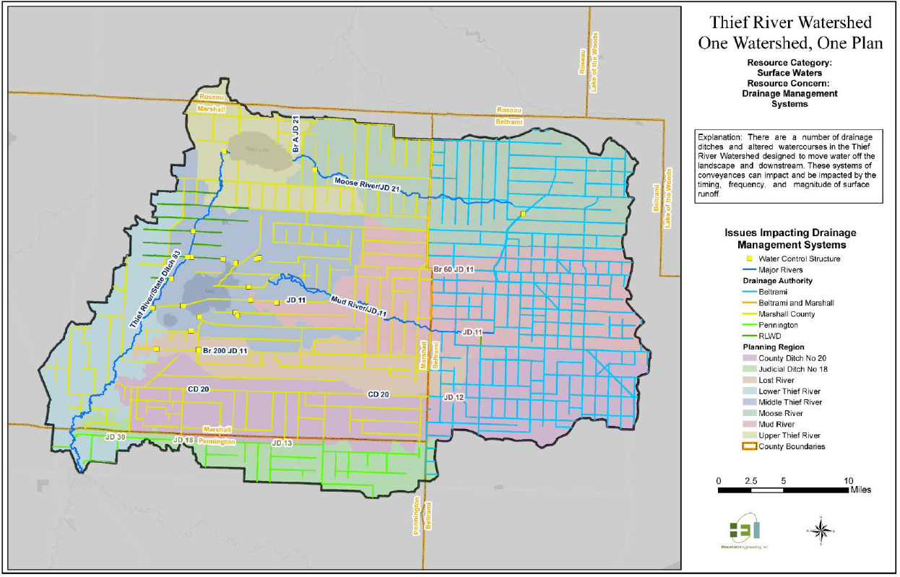
Water Control Structures
30
Impoundments
Most in Agassiz NWR
Moose River Impoundment
Notes:
There are 30 impoundments in the Thief River watershed with the majority located on Agassiz NWR. The Moose River Impoundment in the northeast area of the watershed was completed in 1988 and has a 125 square mile drainage area.

Slide 7
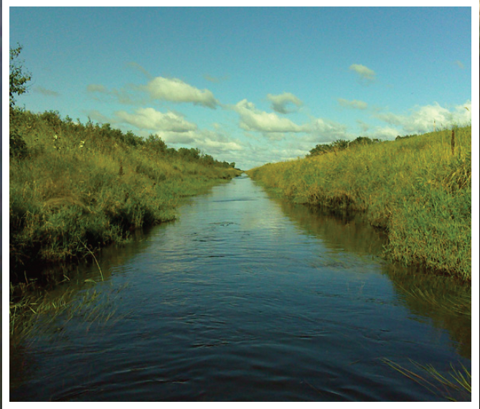
Plan Timeline
Grant Executed – July 2017
Notice of Plan Initiation – August 2017
Public Meetings - January 2018
Plan composed January 2018 to July 2019
Public Hearing on Draft Plan – December 2019
Notes:
Planning started in early 2017 by establishing the Policy and Advisory Committees, developing a Request for Qualifications, and holding consultant interviews. Houston Engineering was selected to write the plan. Once the planning process started we held two public meetings, one in Thief River Falls and one in Grygla in January of 2018. The plan was composed in 5 main sections, each section being approved by the Policy Committee. Once all 5 draft sections were approved, the plan was compiled into the complete draft plan with appendixes another round of review and comments. A Public Hearing was held on December 2nd and following the public hearing, the draft plan was approved by the Policy Committee and then by the individual boards to submit to BWSR.

Slide 8
Plan Overview
Executive Summary
Section 1 – Introduction
Section 2 – Prioritization of Resources, Concerns, and Issues
Section 3 – Measurable Goals
Section 4 – Targeted Implementation
Section 5 – Implementation Programs
Appendices – Land and Water Resources Inventory
Notes:
The basic layout of the plan is section 1 is the introduction, section two is the prioritization of issues, section 3 is the measurable goals, section 4 is the targeted implementation, and section 5 is the implementation programs that exist and planned in the watershed. The land and water resources inventory is included in the appendix.

Slide 9
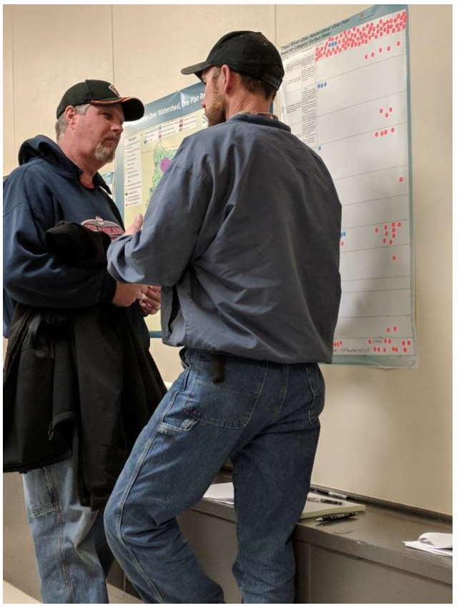
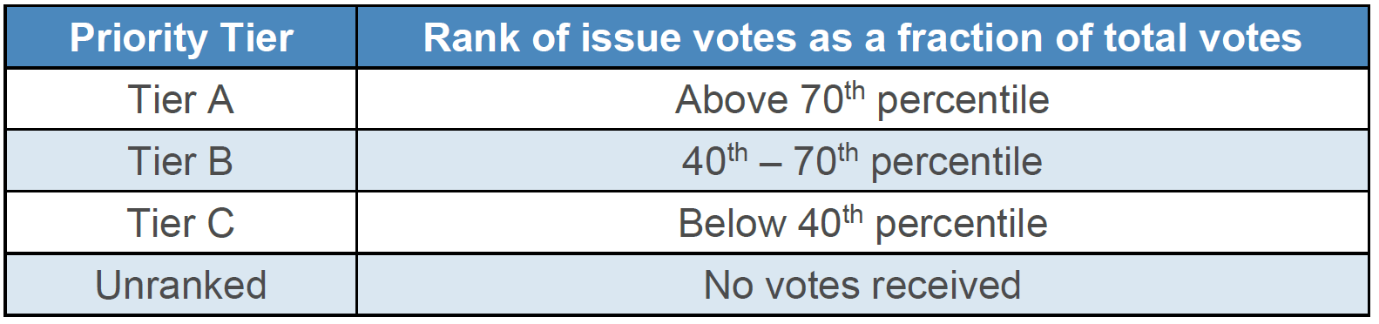
Priority Issues
Issues – Factors such as a pollutant or stressor impacting a resource
27 Issues Identified
  12 Issues in Tier A (Highest Priority)
  15 Issues in Tier B
Notes:
Issues were prioritized through stakeholder input gathered at 2 public kickoff meetings. Residents from the watershed were given 10 orange stickers and placed next to issues they felt were the most important. Water Resource professionals from local, state, and federal agencies were given blue stickers. The responses were totaled and ranked by residents, water resource professionals, and a combined group. The issues were categorized as Tier A, B, or C. priorities based on total number of stickers. After the issues were categorized, the planning workgroup made a final recommendation to the Policy Committee. The Planning Workgroup was asked by the Advisory Committee to provide justification on changes made to the initial ranking which was captured in appendix F.
Resources – natural, economic, biotic, land, or other assets For plan purposes, something that can be managed.
Initially started with 46 Issue Statements

Slide 10
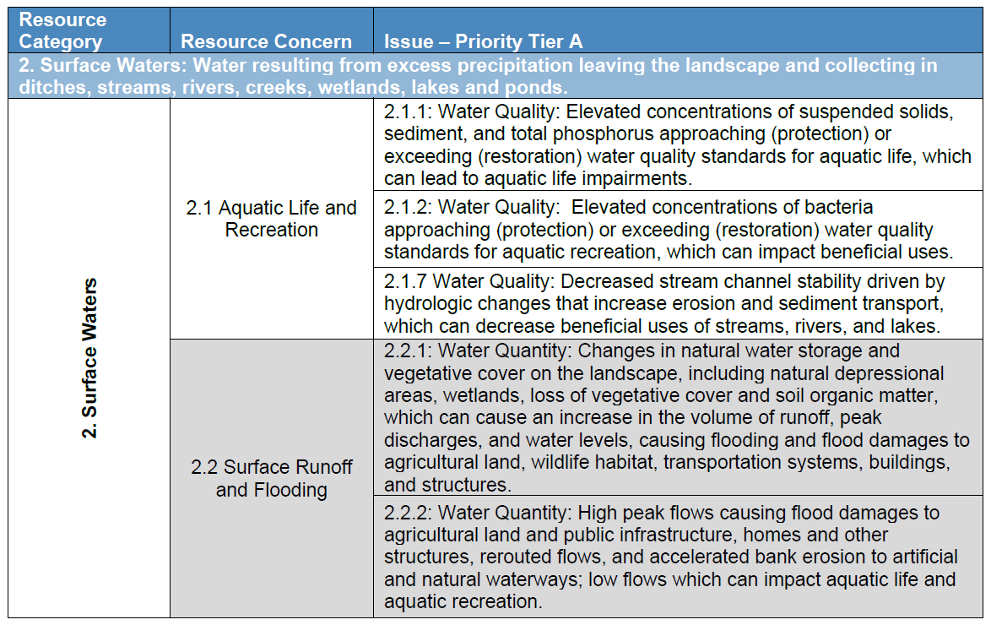
Priority Issues
Notes:
Section 2 of the plan includes the prioritization matrix of Resource Categories, Resource Concerns, and Priority Issues affecting the resource concern. On the right side of the table, we have Priority Tier A Issues for example, 2.1.1: Elevated Concentrations of suspended solids, sediment, and total phosphorus approaching or exceeding water quality standards for aquatic life, which can lead to aquatic life impairments.

Slide 11
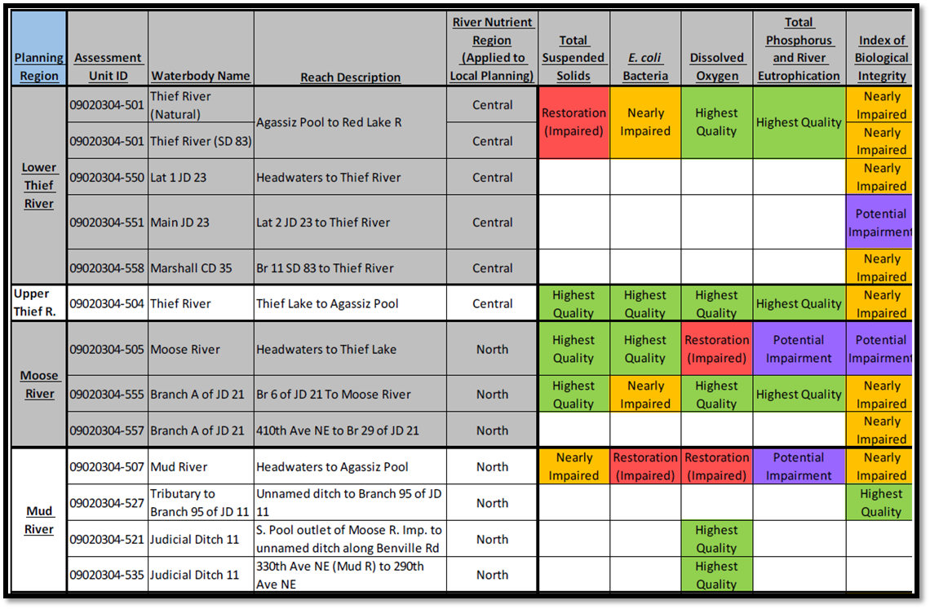
Water Management Classes
Impaired – Restoration
Nearly Impaired – Protection
Highest Quality – Protection
Completed for each AUID
Organized by Planning Region
Notes:
River reaches were categorized into water management classes. Utilizing the WRAPS, the assessed reaches in the watershed were given an impaired, nearly impaired, potentially impaired or highest quality water management class. These water management classes are used to target implementation and assisted with setting measurable goals.

Slide 12
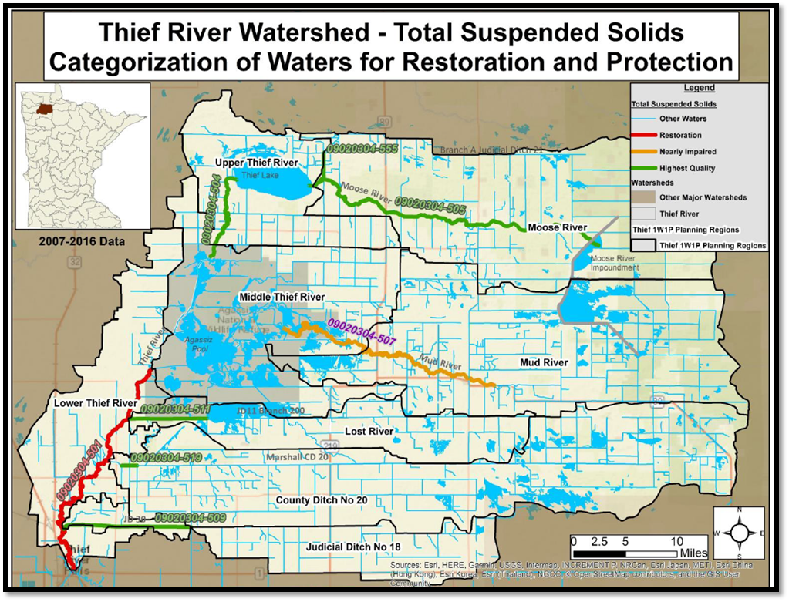
Protection and Restoration for Total Suspended Solids
Red Impaired
  15% Reduction Goal
Orange Nearly Impaired
  10% Reduction Goal
Green Highest Quality
  5% Reduction Goal
Notes:
The lower Thief River downstream of Agassiz National Wildlife Refuge is impaired for Total Suspended Solids while the Mud River is nearly impaired for TSS. Impaired reaches were assigned a 15% reduction goal, nearly impaired a 10% reduction goal, and the highest quality a 5% reduction goal. The potentially impaired also received a 15% reduction goal.

Slide 13
Measurable Goals
13 Measurable Goals Categories
Goals for each planning region (HUC 10)
Goals address one to multiple priority issues
Developed by WRAPS, TMDL, existing plans, studies, and 1W1P process
Notes:
Measurable goals were established for 13 different categories to address the priority issues of concern in Tier A and Tier B. Some of the goals address only one issue of concern while others can address multiple issues of concern. For example, sediment reduction goals address the issue of reduced hydrologic function of wetlands and waters impaired for sediment. Goals were identified for each planning region for sediment, phosphorus, bacteria, dissolved oxygen, and runoff reduction numbers. Other goals include increasing soil organic matter and septic system compliance.

Slide 14
Goals - Sediment
Protection (Highest Quality): Lost River: 5% or 34 tons/yr.
Restoration (Impaired): Lower Thief River/SD 83: 15% or 2,335 tons/yr.
Protection (Highest Quality): Marshall County Ditch 20: 5% or 128 tons/yr.
Restoration (Potential Impairment): Middle Thief River/SD 83: 15% or 653 tons/yr.
Protection (Highest Quality): Moose River/JD 21: 5% or 49 tons/yr.
Protection (Nearly Impaired): Mud River/JD 11: 10% or 290 tons/yr.
Protection (Highest Quality): Upper Thief River/SD 83: 5% or 103 tons/yr.
Protection (Highest Quality): Judicial Ditch 30/18/13: 5% or 70 tons/yr.
These goals address 6 priority issues identified in Section 2
Notes:
Sediment reduction goals were based off the WRAPs and TMDL Reports. Once a reach was assigned a management class, a percent reduction and reduction amount was assigned to sediment.

Slide 15
Goals – Surface Runoff and Flooding
Short-Term Goal(s):
Judicial Ditch 30/18/13: Reduce average annual runoff by 0.125 inches (442 ac-ft)
Lower Thief River/SD 83: Reduce average annual runoff by 0.125 inches (649 ac-ft)
Lost River: Reduce average annual runoff by 0.125 inches (438 ac-ft)
Marshall County Ditch 20: Reduce average annual runoff by 0.125 inches (1396 ac-ft)
Middle Thief River/SD 83: No net increase in average annual runoff
Moose River/JD 21: No net increase in average annual runoff
Mud River/JD 11: No net increase in average annual runoff
Upper Thief River/SD 83: No net increase in average annual runoff
Notes:
Surface runoff reduction goals were initially determined using an existing plan from the RLWD. (distributed detention study?) Through discussion with the advisory committee, planning workgroup, and policy committee the final reduction goals were 1/8 inch in 4 planning regions and no net increase in the remaining planning regions. No net increase was decided because of existing conditions in the planning region including existing impoundments and land use.

Slide 16
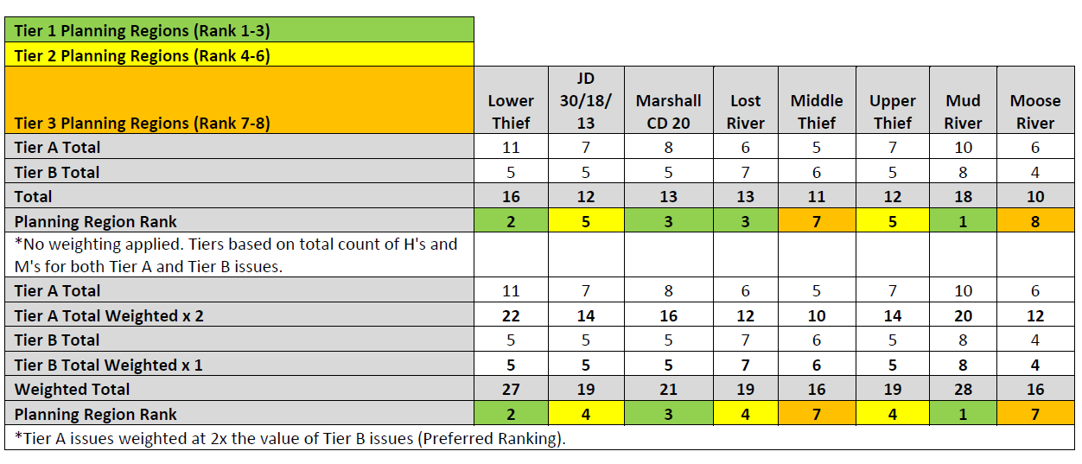
Priority Planning Regions
Notes:
To prioritize the planning regions (HUC 10s) we looked the Tier A and Tier B issues and if they applied to the individual planning regions. Each planning region has it’s own set of issues whether it’s a sediment impairment, dissolved oxygen impairment, or bacteria levels nearing the impairment threshold. Tier A issues were weighted 2 times that of Tier B issues. This gave us the planning region ranks divided into three tiers.

Slide 17
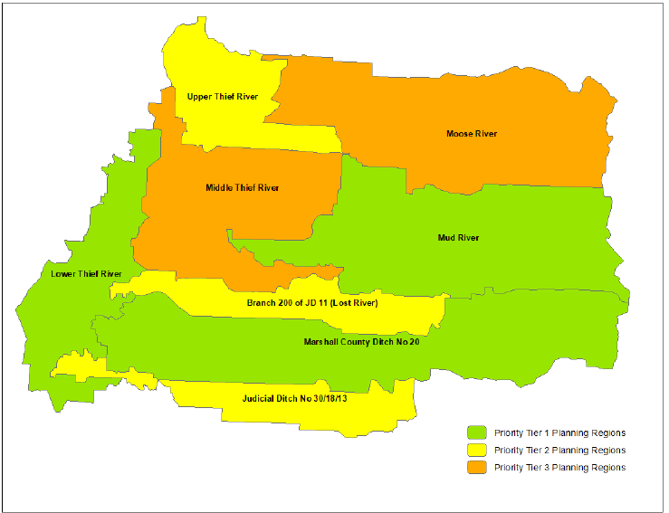
Priority Planning Regions
3 Tiers
Tier 1
  Lower Thief
  CD20
  Mud River
Notes:
Tier 1 are the highest priority subwatersheds to target projects and include the lower thief river, CD20, and the Mud river.

Slide 18
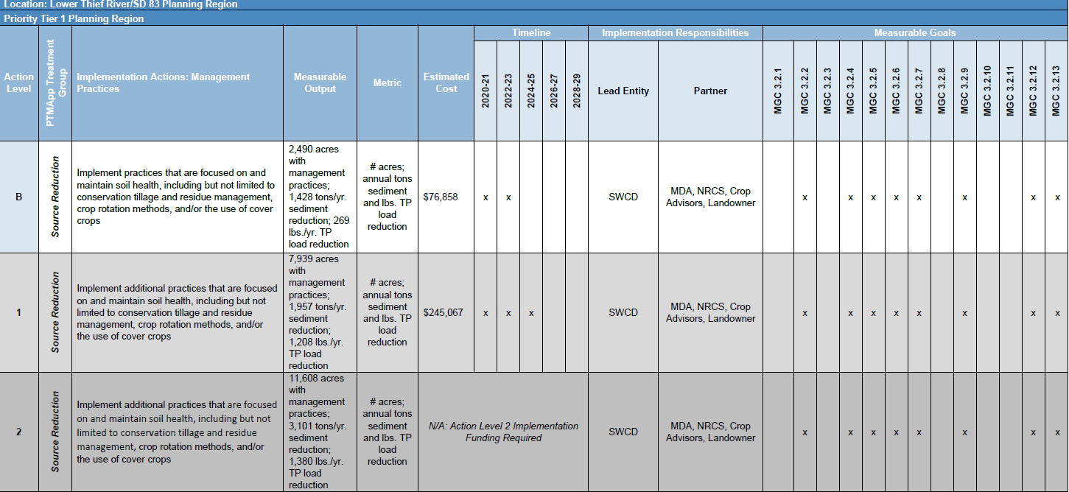
Implementation Table
Notes:
Section 4 of the plan is the implementation schedule that includes actions, anticipated timeline, measurable outputs, the lead entity, partners, and identifies which measurable goals an action will address providing a way to see the multiple benefits of an action or practice. There are implementation tables for each of the planning regions and for watershed-wide actions. Within each planning region, there’s an implementation table for structural practices, management practices, and capital projects.

Slide 19
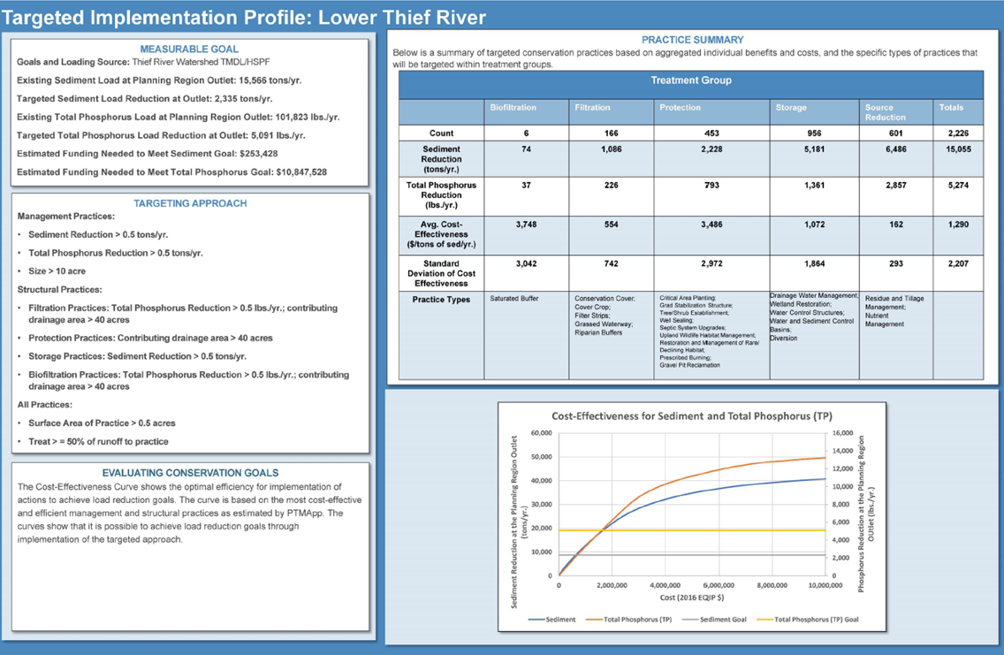
Targeted Implementation Profiles
Each Planning Region
Measurable Goals
BMPs
PTMApp
  Sediment
  Nutrients
  Land Surface – not in channel
Notes:
Targeted implementation profiles were developed using the sediment and phosphorus reduction goals identified in section 3 and the PTMApp. They identify the number of practices, sediment and phosphorus reduction, and average cost-effectiveness of the practices. Treatment groups including storage (WASCOB, stormwater basins, water control structures,) filtration (Cover crop, filter strips, grassed waterway and swales), source reduction (conservation tillage, nutrient management, rotational grazing), and infiltration (alternative tile intakes, multi-stage ditch, lined waterway or outlet), and Protection (grade stabilization structures, streambank stabilization, tree/shrub establishment, critical area plantings).

Slide 20
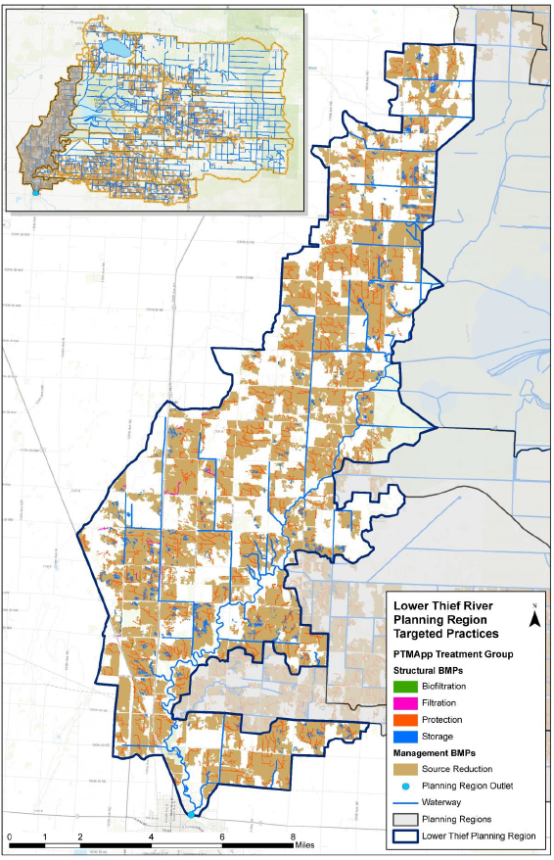
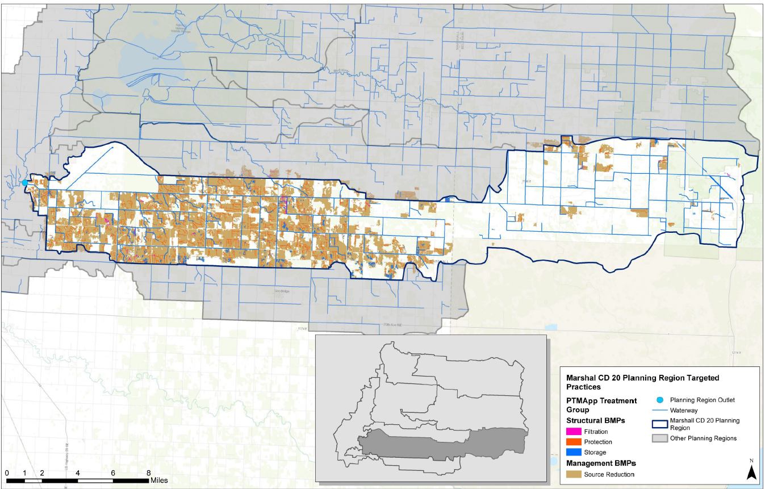
PTMApp - CD20 and Lower Thief River
Notes:
In addition to the targeted implementation profiles, the plan includes PTMApp maps for each planning region that identifies areas to implement priority practices. BMPs were selected so that structural and management practices contributed 50% estimated load reductions towards the goals. Priority locations for protection practices, including grade stabilization structures, are identified in red on the maps. Priority location for management practices are identified in brown.

Slide 21
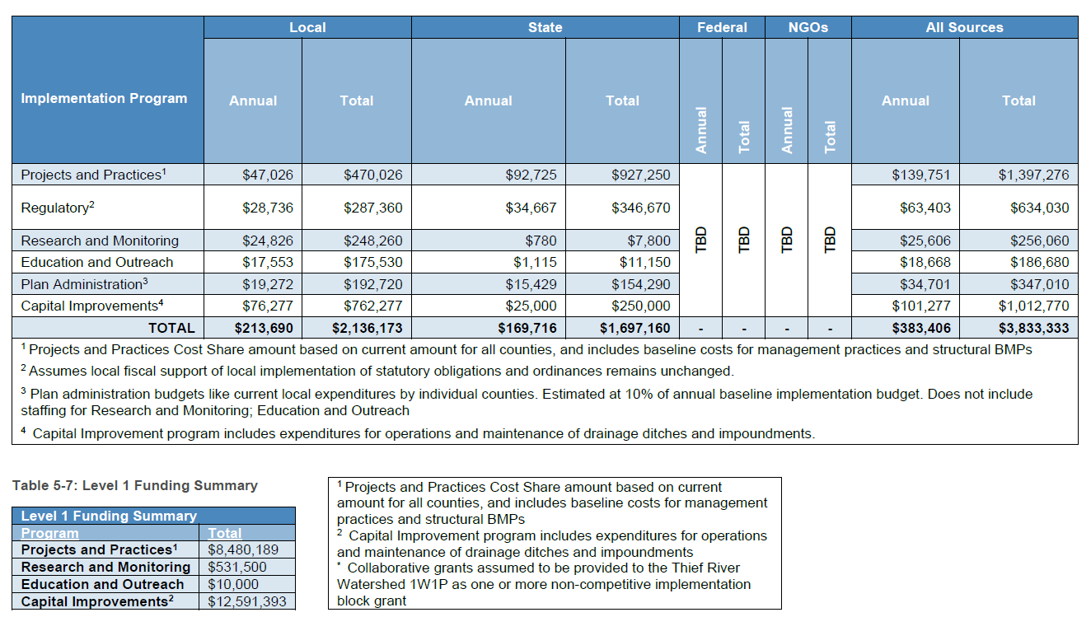
Budget
Notes:
A baseline budget that included projects and practices, research and monitoring, education and outreach, and capital improvements was developed. This was developed by looking at each LGUs existing budget of what’s being spent in the Thief Watershed. Level 1 funding is the next level with the intent to use Watershed Based Funding and competitive clean water fund grants to implement projects identified in the targeted implementation plan. Actions for level 2 funding are listed ins section 4 but do not have specific budgets – These projects would be large scale capital improvement projects.
Baseline Totals: 10 year - $3.8 million
Level 1 Total: 10 year - $21.6 million

Slide 22
Next Steps
Appoint Fiscal Agent and Coordinator
Adopt the final plan
Finalize the development of 2 year workplan
Continuation of Committees
  Policy Committee
  Advisory Committee
  Planning Workgroup
Notes:
The Policy and Technical Committees will continue to meet to discuss the 1W1P, completed projects, and future project implementation. Annual reports and workplans will be discussed as well as joint project opportunities that cross county boundaries. The planning group will meet quarterly to discuss current, completed, and future projects and develop an annual report that will be given at the annual policy and technical committee. LGUs will take turns holding the planning group meetings.

